Slide 1
Front-End Web Development Using React (Client Side Technologies-HTML)
Front-End Web Development Using React – HTML
Eng. Reem Hassan Ahmed

Slide 2
Contents of this lecture
Introduction to Web | What is web development?
Web page creation | Clarification on how web pages are created
Client-Side technologies | Client-side languages
For more info: SLIDESGO | SLIDESGO SCHOOL | FAQS
You can visit our sister projects: FREEPIK | FLATICON | STORYSET | WEPIK | VIDFY

Slide 3
04
Intro to HTML
Front-End Web Development Using React – HTML

Slide 4
Table of contents
01
02
03
04
05
06
Client-side languages
HTML intro
What happens when we browse a website?
You can describe the topic of the section here
HTML basics
HTML iframe
You can describe the topic of the section here
You can describe the topic of the section here
HTML tables
HTML forms
You can describe the topic of the section here
You can describe the topic of the section here

Slide 5
HTML Links
Syntax:
Example: <a href="https://www.google.com/">Google</a>
target attribute: attribute specifies where to open the linked document.
_blank value: Opens the document in a new window or tab.
Example: <a href="https://www.google.com/" target="_blank">Google</a>

Slide 6
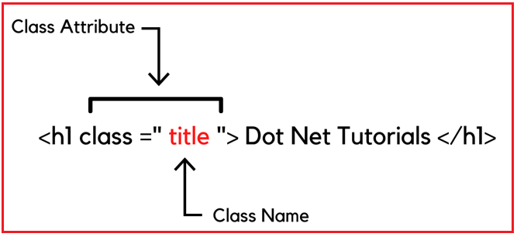
HTML Classes
The HTML class attribute is used to specify a class for an HTML element.
Multiple HTML elements can share the same class.

Slide 7
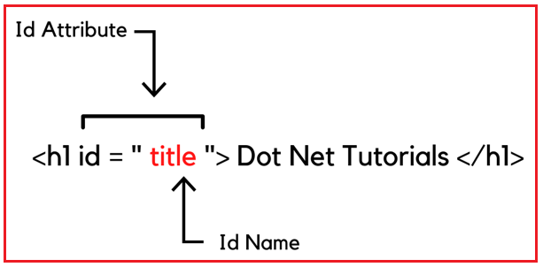
HTML id
The HTML id attribute is used to specify a unique id for an HTML element.
You cannot have more than one element with the same id in an HTML document.

Slide 8
HTML file path types
Absolute : Specify the complete location of a file in a system, starting from the root directory. They include the full directory path, ensuring precise file identification regardless of the current directory location.
Relative : Refers to the location of a file relative to the current web page’s location.

Slide 9
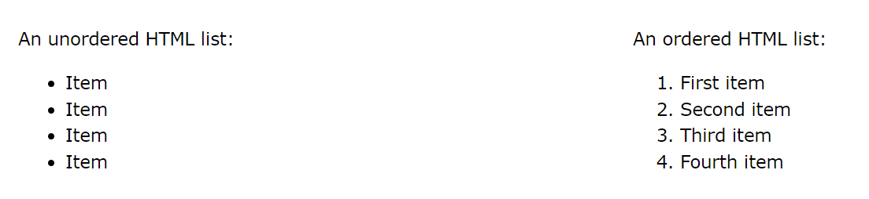
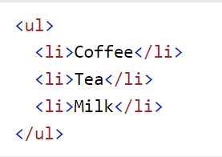
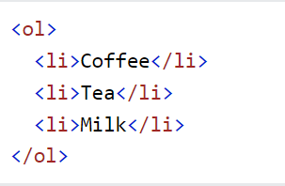
HTML lists

Slide 10
HTML iframe
Iframe is used to display a web page within a web page.
Syntax:
Example: <iframe src="https://iti.gov.eg" name="iframe" title="Iframe Example"></iframe>

Slide 11
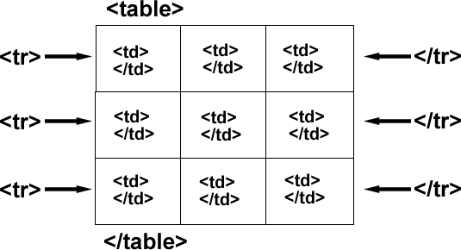
HTML tables
Each table row starts with a <tr> and ends with a </tr> tag.
Each table cell is defined by a <td> and a </td> tag.
Sometimes you want your cells to be table header cells. In those cases use the <th> tag instead of the <td> tag:

Slide 12
HTML Forms
Forms are used to collect user input. The user input is most often sent to a server for processing.
The HTML <form> element is used to create an HTML form for user input
The action attribute defines the action to be performed when the form is submitted.
The method attribute specifies the HTTP method to be used when submitting the form data.

Slide 13
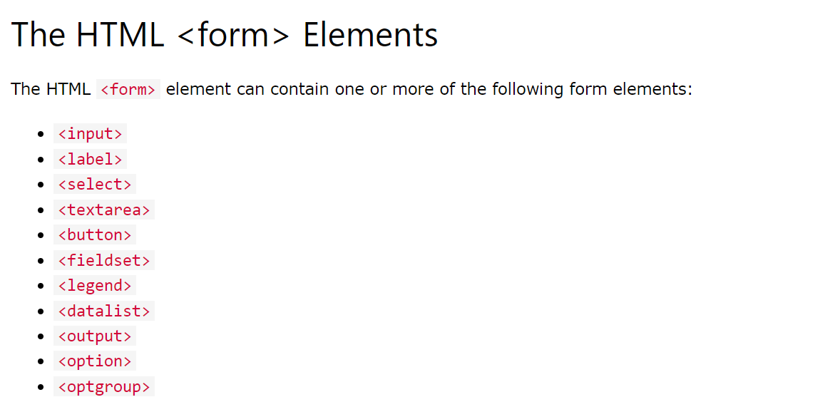
HTML Forms

Slide 14
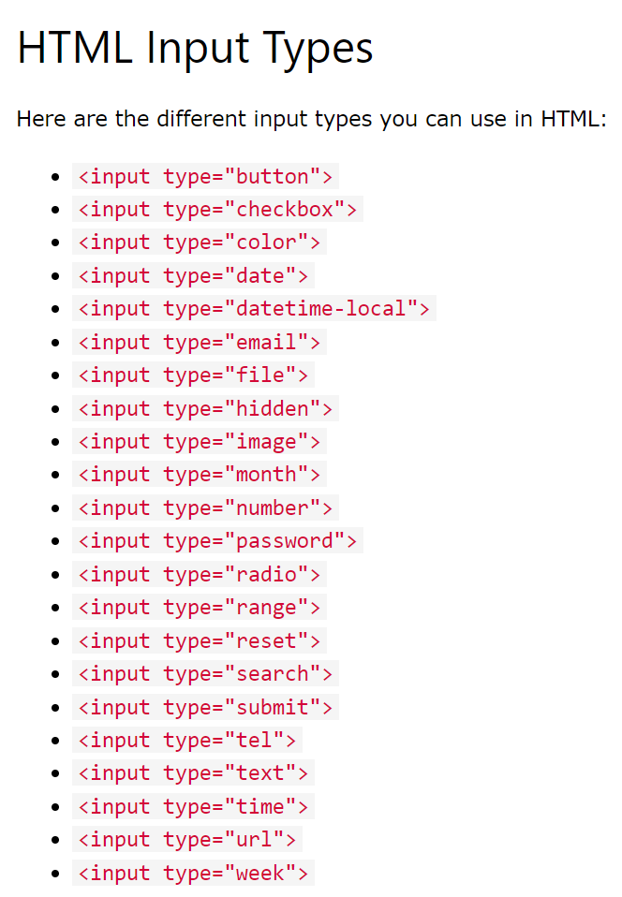
HTML Forms
Input element types and attributes:
The value Attribute
The readonly Attribute
The disabled Attribute
The size Attribute
The maxlength Attribute
The placeholder Attribute The required Attribute

Slide 15
Thanks!
Front-End Web Development Using React – HTML
Does anyone have any question?
ReemHassan160299@gmail.com
+201092427577
Please keep this slide for attribution

